Slide 1
Paperless Overview
Reporter: Mai Tuyen (梅玉宣)

Slide 2
1, Struct system
Paper
Checksheet
FAI
Exhaust pipe
Abnormal
Manager
(5)
(6)
Checker
(1)
Paperless System
(4)
Reviewer
(2)
(3)
1, Scan QRCode and checking follow step in paper
2, System send notify and support statistic data
3, Signing report and statistic history by QRCode and time
4, System send notify and support statistic data checking
5, Request
6, Statistic and analysis data in system

Slide 3
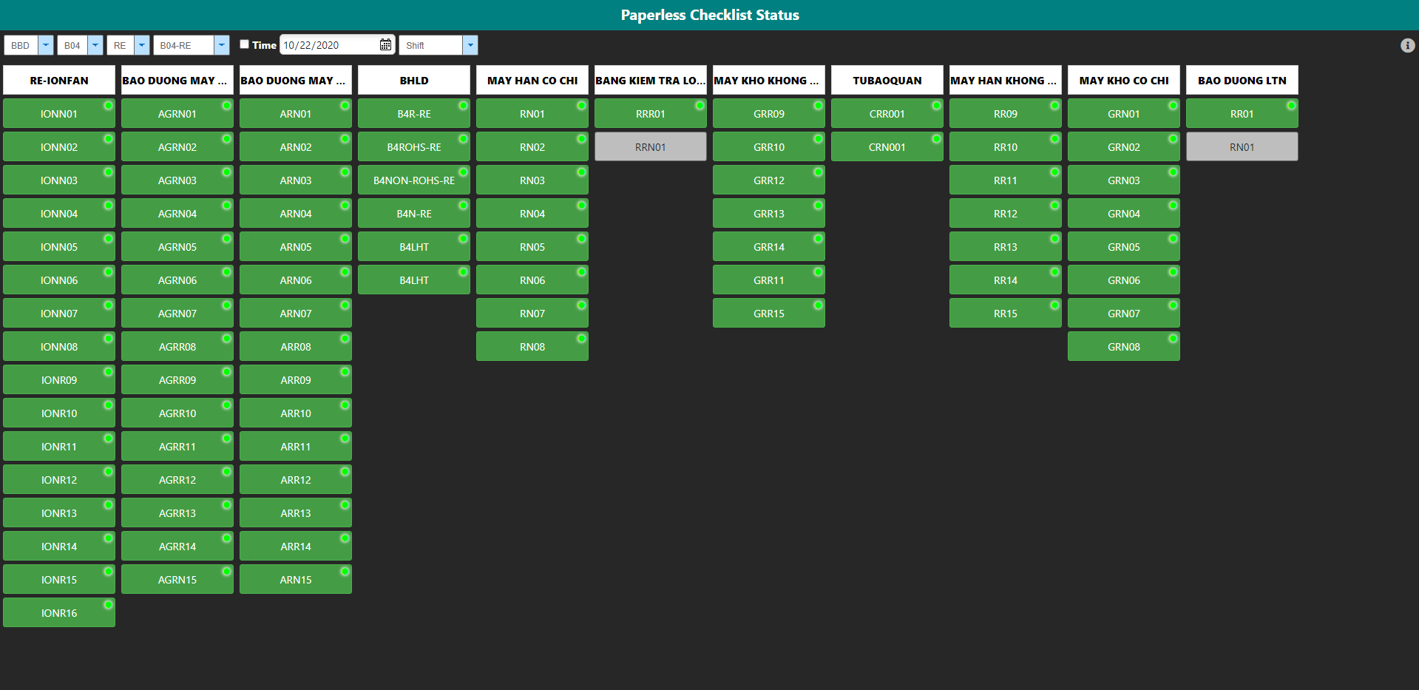
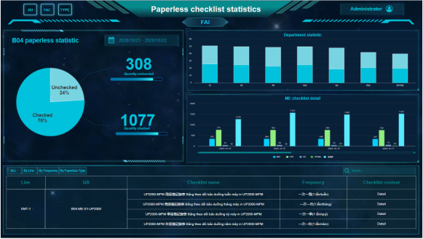
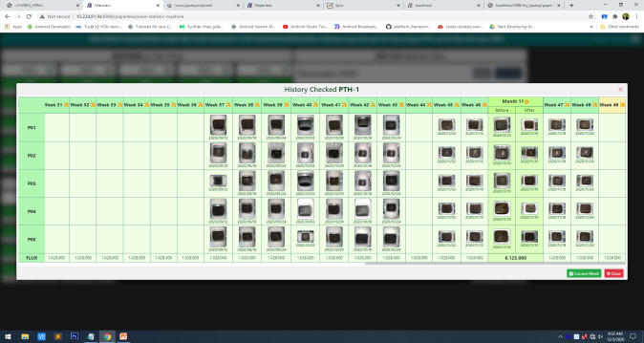
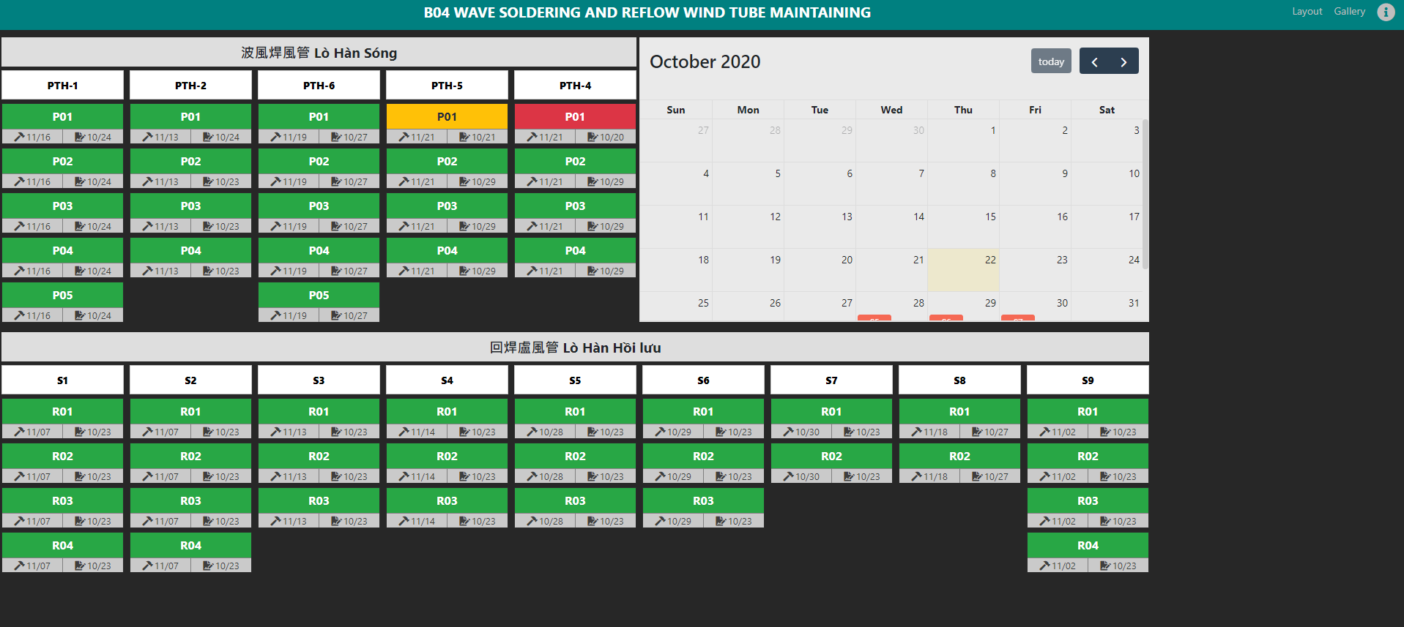
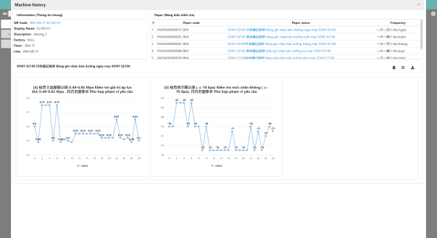
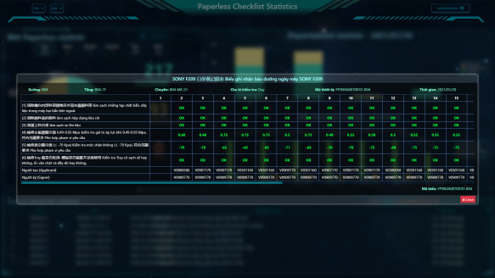
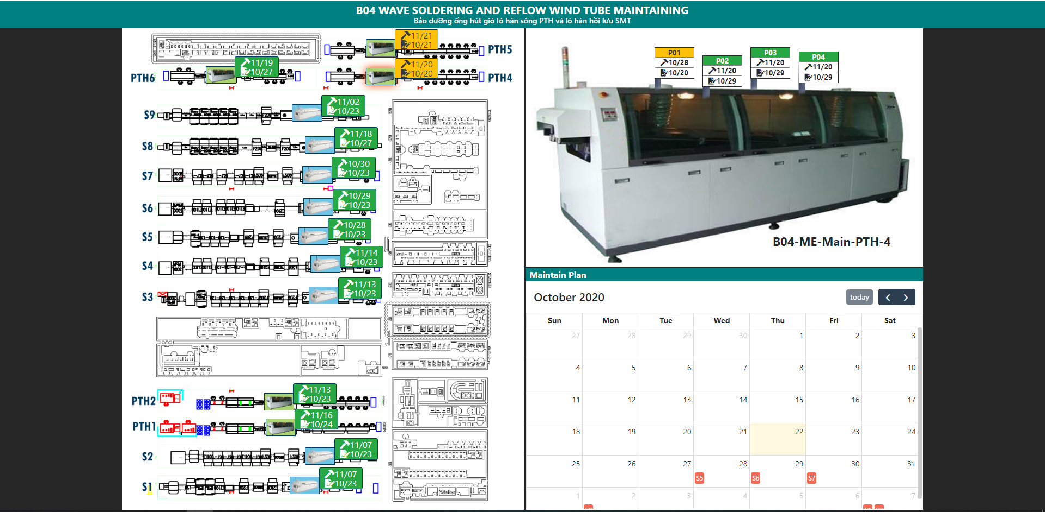
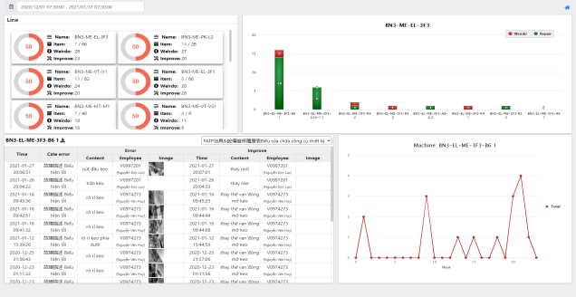
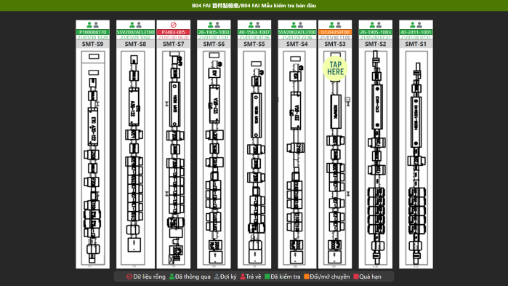
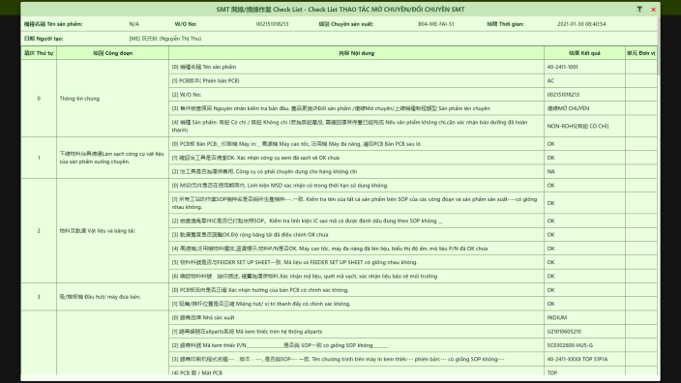
2, Module
Checklist
Exhaust pipe
FAI

Slide 4
Subject | Paperless checklist Improvement
No | Item | Content | Due date | Owner
1 | System | 1, Notify abnormal: When checker find issue NG in report, the system will send notify for manager | Done | IT Tien QA Cuc- Verify
 |  | 2, Update struct data setup (QRCode, BU, Factory) | Done
 |  | 3, When the paper update version by ISO, the system will send notify to manager | Open
2 | Web | 1, Re-sort list function by permission user in system | Done | ME/Ruby-Hat QA 輝達
 |  | 2, Update name and re-group function in menu left (Follow with function sign, history, manage, statistic and analysis) | Done | QA 輝達 ME/Ruby-Hat FII 梅玉宣
 |  | 3, Support user export data statistic and analysis with chart view | Done | FII/裴詹勝/阮德進 ME/Hat,Loi
 |  | 4, Update UI for sign waiting(signer/manager) page | Open | FII 梅玉宣 QA verify ME verify
 |  | 5, Update Wave soldering & reflow checking page (BOM Config and Flux Statistic) | Done | FII 梅玉宣 ME verify
 |  | 6, Update struct lock line for ME BN3(PROCESS, FAIL, PASS) | Done | FII 梅玉宣
 |  | 7, Update UI for system (Title Page, content, menu) | Done | FII 梅玉宣
 |  | 8, Update search data (Search by QRCode, Form) | Open
 |  | 9, Dashboard for checklist in paperless system | Done | FII 梅玉宣
3 | App | 1, UI & UX (Change language, search data, smart login) | Open | FII 梅玉宣
 |  | 2, Checking history (QRCode, Paper) by time | Done | FII 梅玉宣 QA verify
 |  | 3, Notify (Abnormal, Maintain, Checksheet, FAI, Audit) | Open | FII 梅玉宣 QA verify
 |  | 4, Create view FAI checking (beta) for B04 (Testing line SMT-S1) | Done | FII 梅玉宣 QA verify

Slide 5
Subject | FAI Improvement
No | Item | Content | Due date | Owner
1 | System remind to do FAI | 1. Short action: 1.1.Changing line: IT-Allpart catch the information of first PCBA passed to ''AUTO SCAN'' station then alarm '' it time to do FAI'' to AOI screen. 1.2. For MO that ran from previous shift: fixed at 9h & 19h IT-Allpart will send information to remind : '' it time to do FAI'' to AOI screen. | Done | IT Tien QA Cuc- Verify
 |  | 2. IT-Allpart supports data table to insert which MO or change shift need to make FAI information, FII sync data then update on dashboard to notice checker, if FAI report ready, FII will update success flag in data table let IT confirm lock H1 or not 10/07: IT Finish data table and information setting on Allpart 10/22: Maping data form IT Allpart to Paperless FII 10/26: Auto fill MO and model name to report FAI from data IT Allpart 11/20: IT Allpart send to FII-SW data line running/stop 11/26: IT Allpart update data change MO and change shift | Done | FII 何曰福 (Wk44) IT-allpart/Chung (Wk41)
2 | FAI content | 10/08: Review all item in the SMT FAI format: remove or add some item if need. Document No: FM3NVA037005E | Done | ME/Ruby-Hat QA 輝達
3 | Separate kind of FAI | Have no final decision yet: suggest separate two kind of ROHS & Non-ROHS from (If factory produces only ROHS products then choose ROHS form and If factory produces ROHS & Non-ROHS product then choose Non-ROHS form). 11/19: ME send to FII-SW product information (ROHS/Non-ROHS) FII-SW will research struct system and setup product (ROHS/Non-ROHS) to system | Done | QA 輝達 ME/Ruby-Hat FII 梅玉宣
4 | Auto upload actual FAI's information into paperless system | 10/06: ME provide all kind of mouting machine, solder paste printer, SMT reflow, AOI to Fii. 10/22 (FII): Create program screen display 10/26: Install and test program to machine in line SMT 11/11: Image process get information on screenshot of machine (SMT-S3/Reflow) 11/19: Testing read data screen on HELLER(S3 + S5) and fill data to APP (ME) 11/26: [Solution] Get data machine from server ME and fill data to report FAI 12/11: Create program screenshot 12/17: Checking Open port connect data from server ME to machine in Line SMT 2. Fii login directly to machine to get information=> make a QR code=> OP scan QR code=> all FAI information need for that machin auto upload to paperless system. | Ongoing | FII/裴詹勝/阮德進 ME/Hat,Loi IT/ Lam, Viet
5 | Data analysis | Upgrade sign module: The system will support signer auto calculator ratio OK/NG of report | Open | FII 梅玉宣
6 | Display FAI's result on the paperless system | 10/08: Review design by layout 10/22: + View demo layout B04 – SMT FAI checking (beta: http://10.224.81.94:8888/paperless/b04-fai-2) 10/26: Create view check FAI in App 10/27: Update function history checked in page 11/26: [Solution] Update check value for item special for FAI report | Done | FII 梅玉宣

Slide 6
Subject | FAI Improvement
No | Item | Content | Due date | Owner
7 | Set up the range for any parameter of new product | FII help to update- user can set up the range for any parameter of new product to avoid incorrect FAI's result entry. 11/06: Review setup spec and unit for step by model and line + FII create function import file config spec and unit for ME + ME update spec for step in file 11/10: + Update logic for spec management checklist FAI + Asynchronous data model and wo in line 11/17: ME send to FII-SW unit of station on SMT-S3 11/18(Ongoing): + Research struct database for module spec management (done) 11/25: Config unit for line SMT-S3 (Done) 11/26: [Solution] ME send to FII-SW product information | Done | FII 梅玉宣
8 | Current paperless system need improve | 7.1.After leader reject any FAI=> operator can EDIT instead of make new one as curently. | Open | FII 梅玉宣 QA verify
 |  | 7.2. If any item that Must to take photo ( must add photo into paperless system) then the system icon to be photographed must be displayed in RED | Done | FII 梅玉宣 QA verify
 |  | 7.3. If the FAI result entered into the system is different from the previous results entered, the system will alert the importer and the signer so that they can check again. | Open | FII 梅玉宣 QA verify
9 | Check sheet display on WEB UI | 10/07: Review meeting FAI content and confirm change to excel form style (http://10.224.81.94:8888/paperless/b04-fai-2) | Done | FII 梅玉宣 QA verify
10 | Make form | Spec, Unit definition: + Unit definition: Setup successful for Reflow and Printer on line SMT B04 12/11 Spec definition: Setup spec with model and line | Done | FII 梅玉宣 ME/Hat
11 | Checklist Report | Data collection automatic fill content Update struct data and view create ECN (PN before/PN after/location) Update logic checking ECN - Upload Data Validation (Open) | Ongoing | FII 梅玉宣 IT/ Long ME/ Ngoc

Slide 7
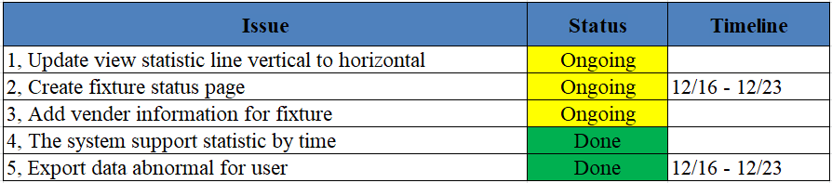
Issue BN3

Slide 8
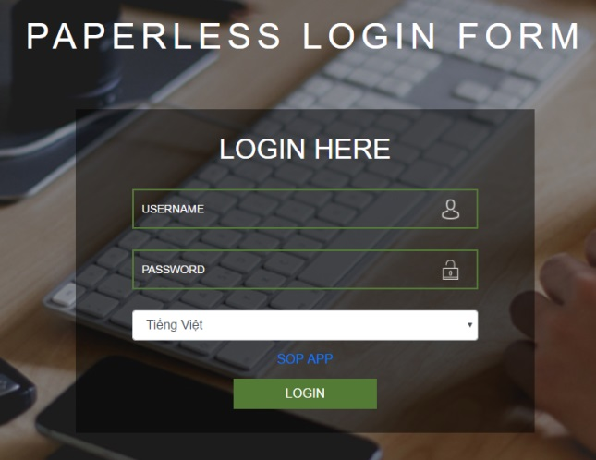
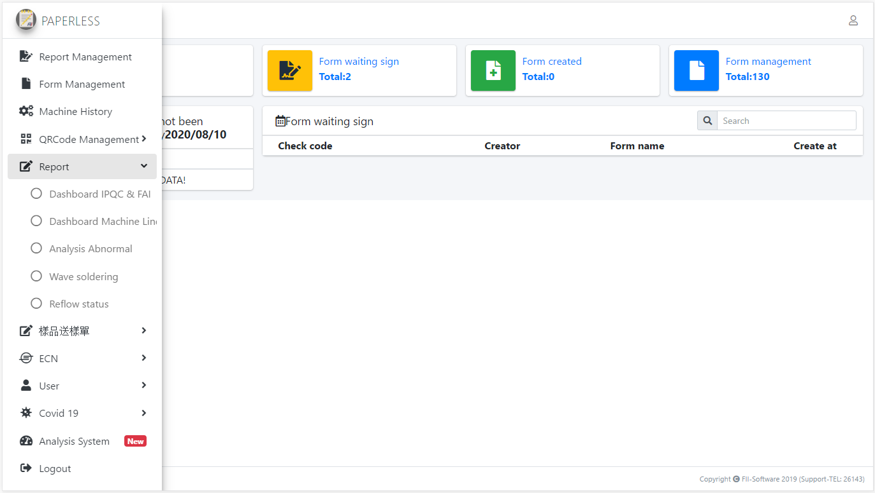
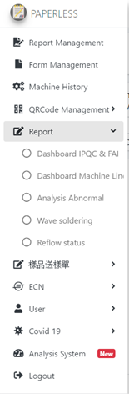
Total report waiting
signfor user
Total report
user have checked
Total paper
of department
1
2
3
4
5
5.1
5.2
Page login
5.3
1, Report management: Statistic list report waiting sign
by user login, they are filter by status of report(Approve,
Reject, process)
2, Form management: Statistic list paper with Factory and
team by user login, they are create and edit content of paper
3, Machine history: Checking history checked with time
span and QRCode and Paper form
4, QRCode management: Statistic list QRCode with Factory
and team by user login, they are create and edit QRCode,
setup paper for QRCode, setup model and version program
for Paper with QRCode
5, Report: (Statistic and anailysis)
(5.1) Dashboard IPQC-FAI (Beta): BN3-IPQC
(5.2) Dashboard machine line (FAI and Paper have cicyle time): All user
(5.3) Analysis Abnormal (Paper maintain and paper repair): All user
(5.4) Wave soldering (Beta): B04-ME Statistisc Galley by Machine
(5.5) Reflow status (Beta): B04-ME Checking status checked machine
6, 樣品送樣單 (Sample inspection paper): for PM
7, ECN (ECN paper): for PM
5.4
5.5
6
7
8
9
10
Page home
8, User: Checking profile of account and update profile user
9, Covid 19: Storage temperature measurement (HR)
10, Analysis System: Tracking usage status
http://10.224.81.94:8888/paperless/

Slide 9
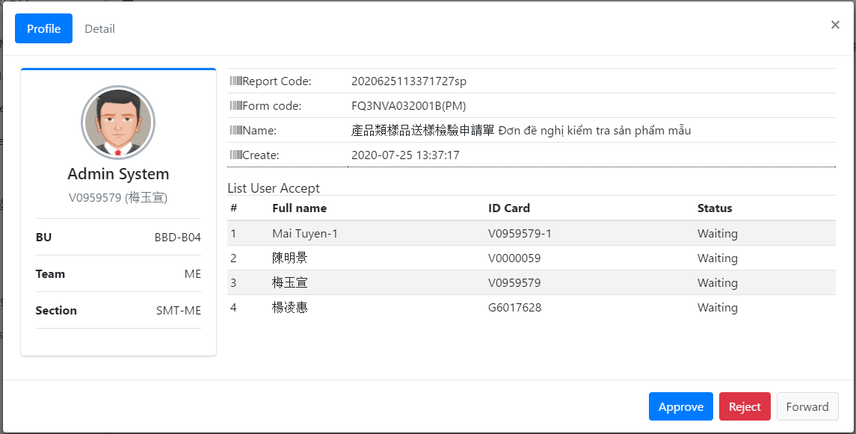
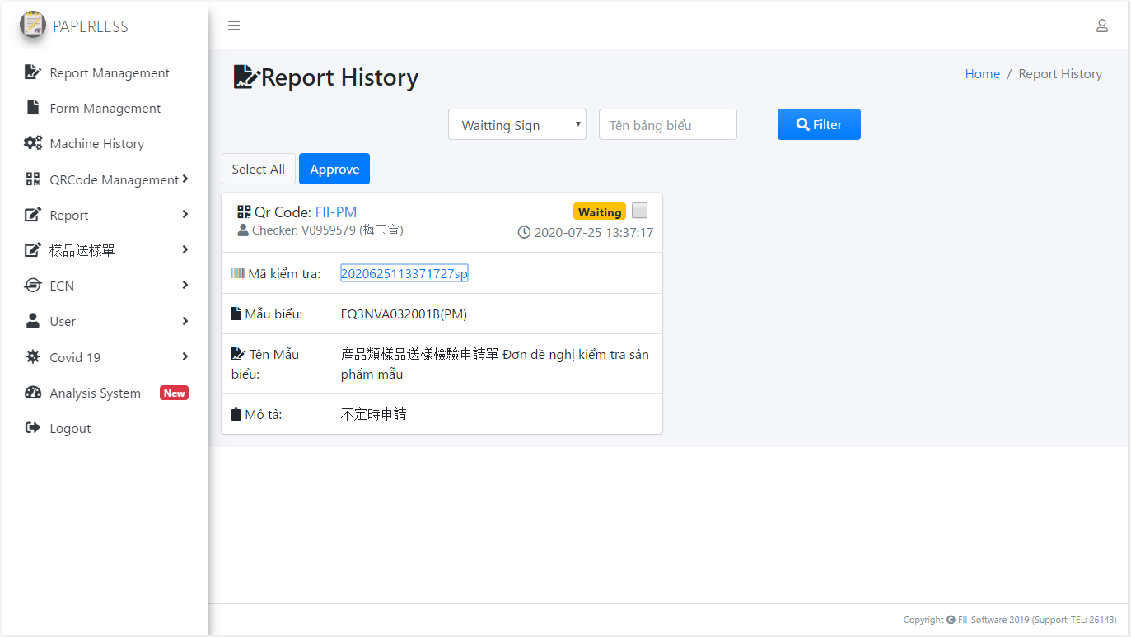
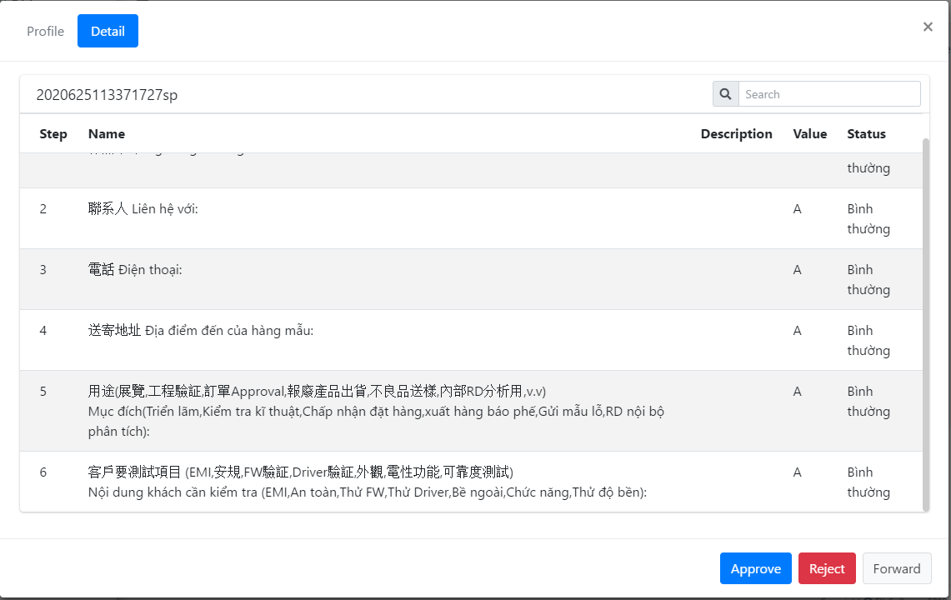
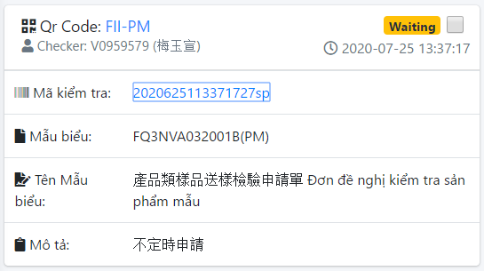
1, Report management
Profile report
Report need sign
Profile checker
Sequence signing
Step name
Value checked
Click
“report code”
(QRCode checked)
Report status
Time checked
Report code (system auto create)
Paper Code
Paper name
Note: Statistic list report waiting sign by user login, they are filter by status of report(Approve, Reject, process)
http://10.224.81.94:8888/paperless/report-history

Slide 10
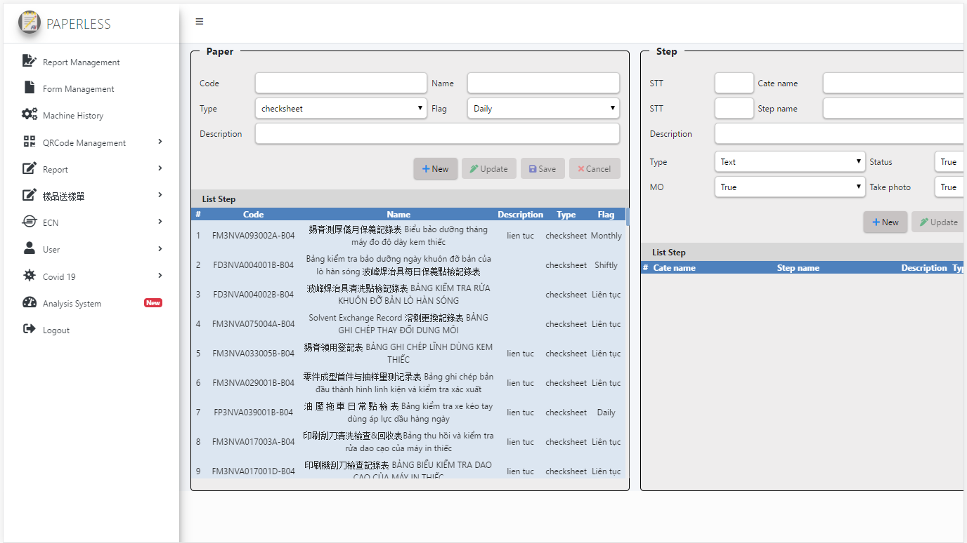
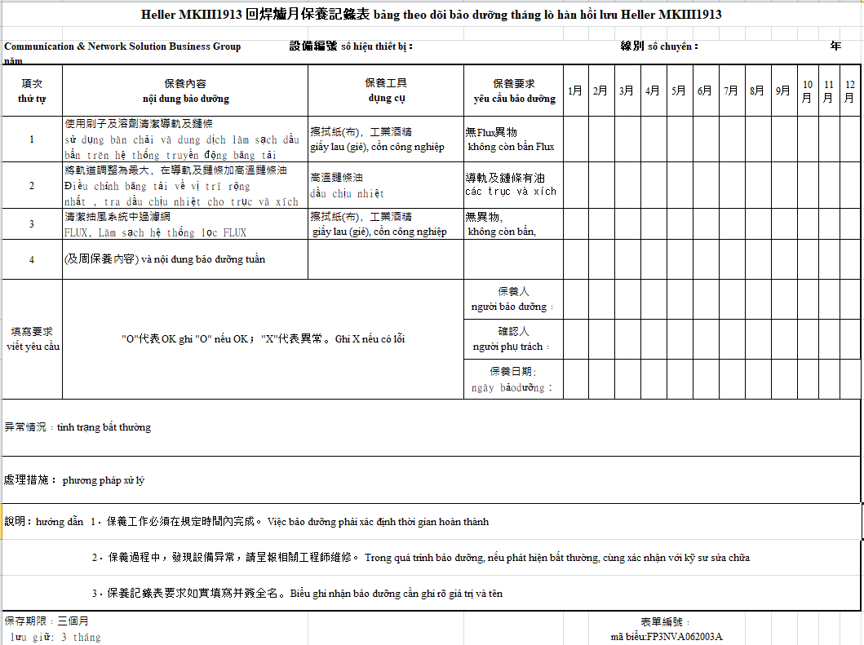
2, Form management
Step need check of paper
Profile of paper
Step need check of paper
Note: Statistic list paper with Factory and team by user login, they are create and edit content of paper
http://10.224.81.94:8888/paperless/report-form

Slide 11
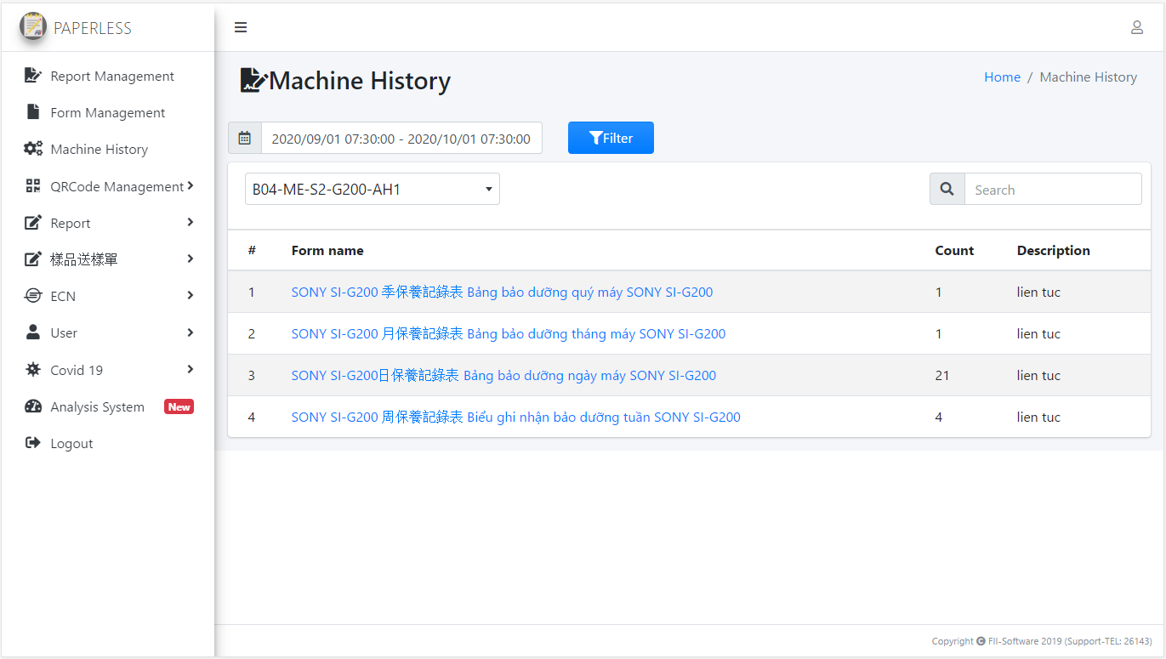
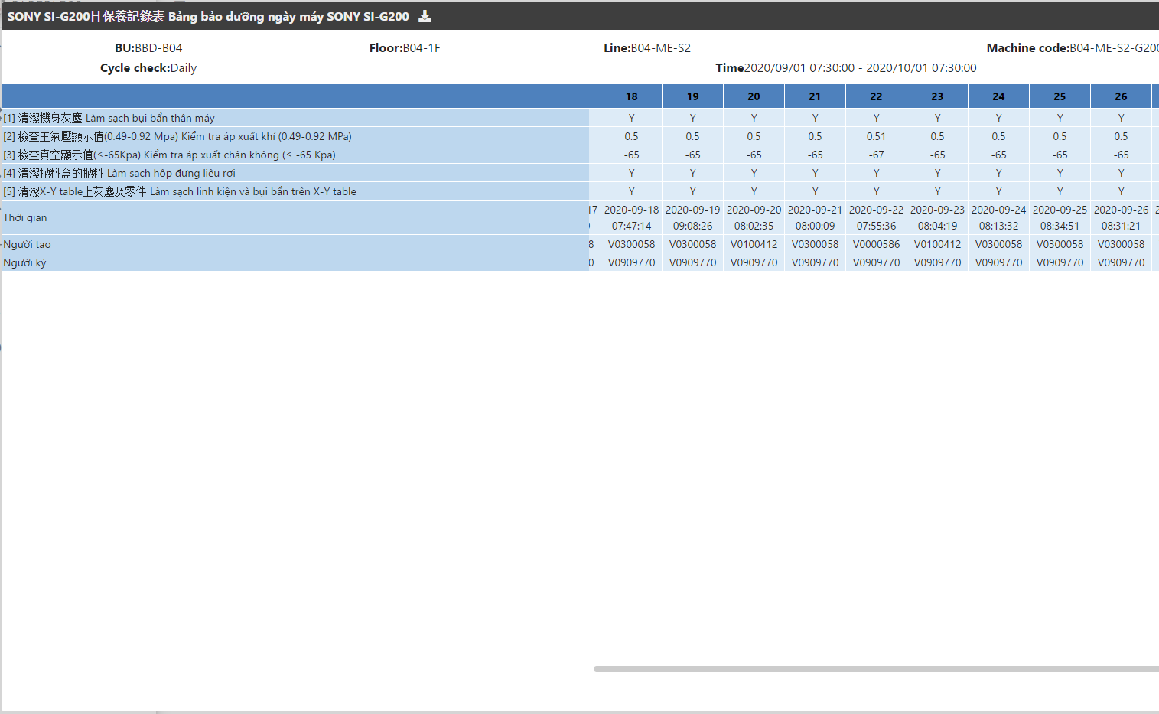
3, Machine history
1, Setup time checked data
2, Click filter
Choose QRCode need checked
List Paper usage by QRCode
Click paper
Note: Checking history checked with time span and QRCode and Paper form
History checked have statistic with
cycle time (Shiftly, Daily, Weekly,…)
http://10.224.81.94:8888/paperless/machine-history

Slide 12
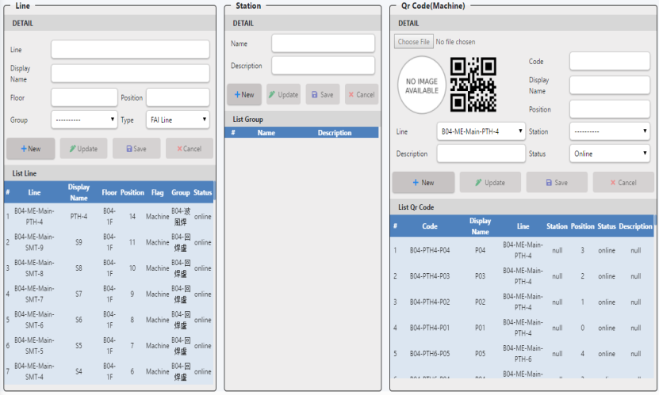
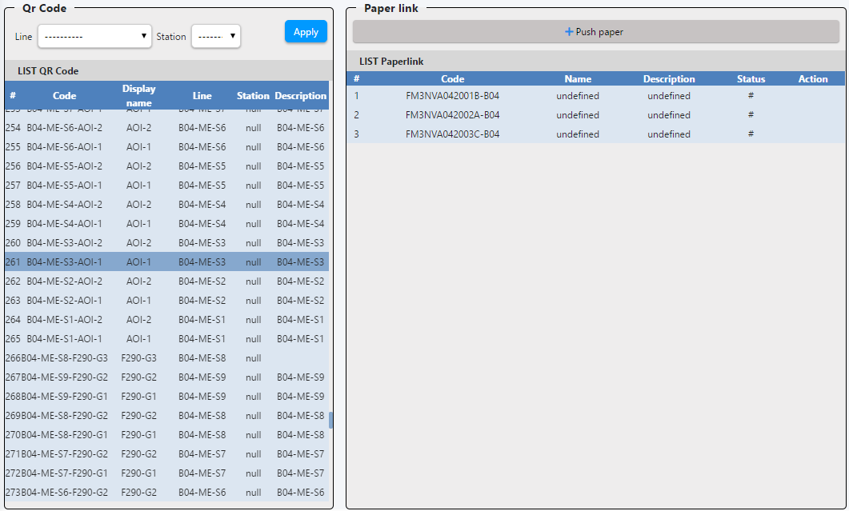
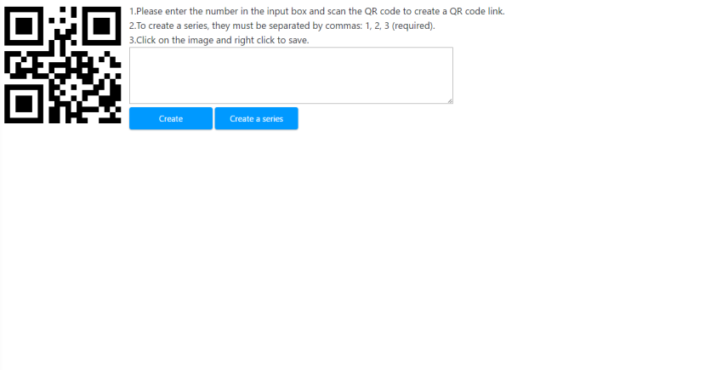
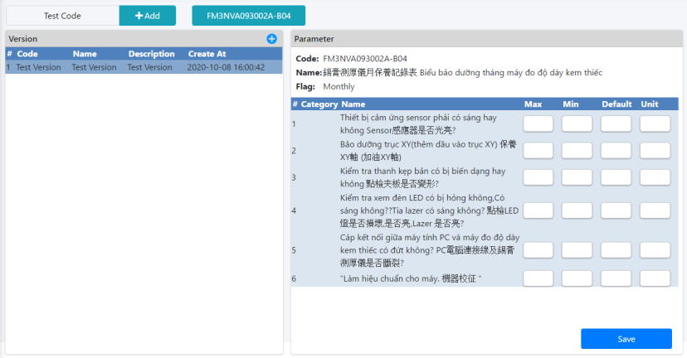
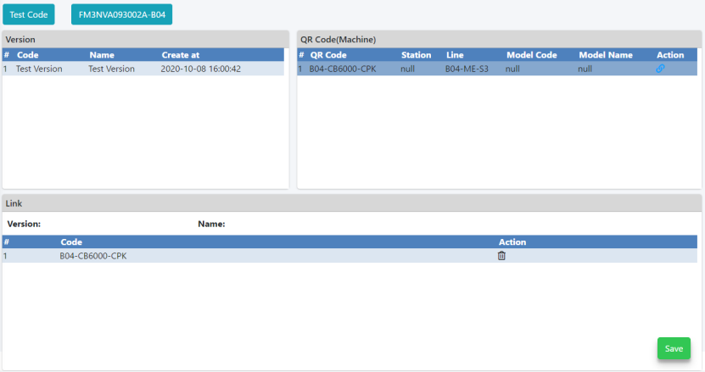
4, QRCode management
Create QRCode
Link QRCode - Paper
QRCode management
Create QRCode
Link QRCode - Paper
Print QRCode
Model
Model - QRCode
Print QRCode
Model
Model - QRCode
Note: Statistic list QRCode with Factory and team by user login, they are create and edit QRCode, setup paper for QRCode, setup model and version program for Paper with QRCode

Slide 13
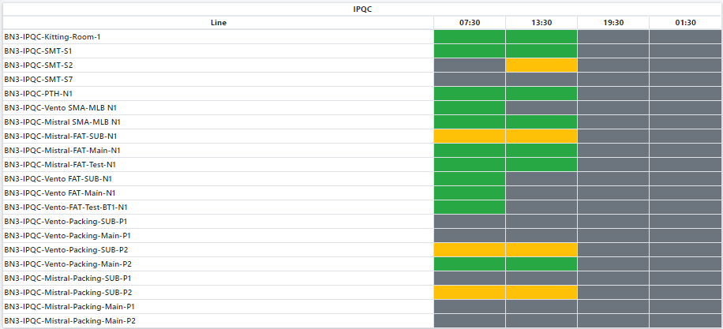
5, Report
REPORT
Paper checking with lession 6h
Dashboard IPQC - FAI
Dashboard Line Machine
Analysis Abnormal
Wave soldering
Reflow status
List Station and line
Lession 1
Lession 2
Lession 3
Lession 4
Note: Checking status checked by lession 6h for BN3-IPQC
http://10.224.81.94:8888/paperless/ipqc-dashboard

Slide 14
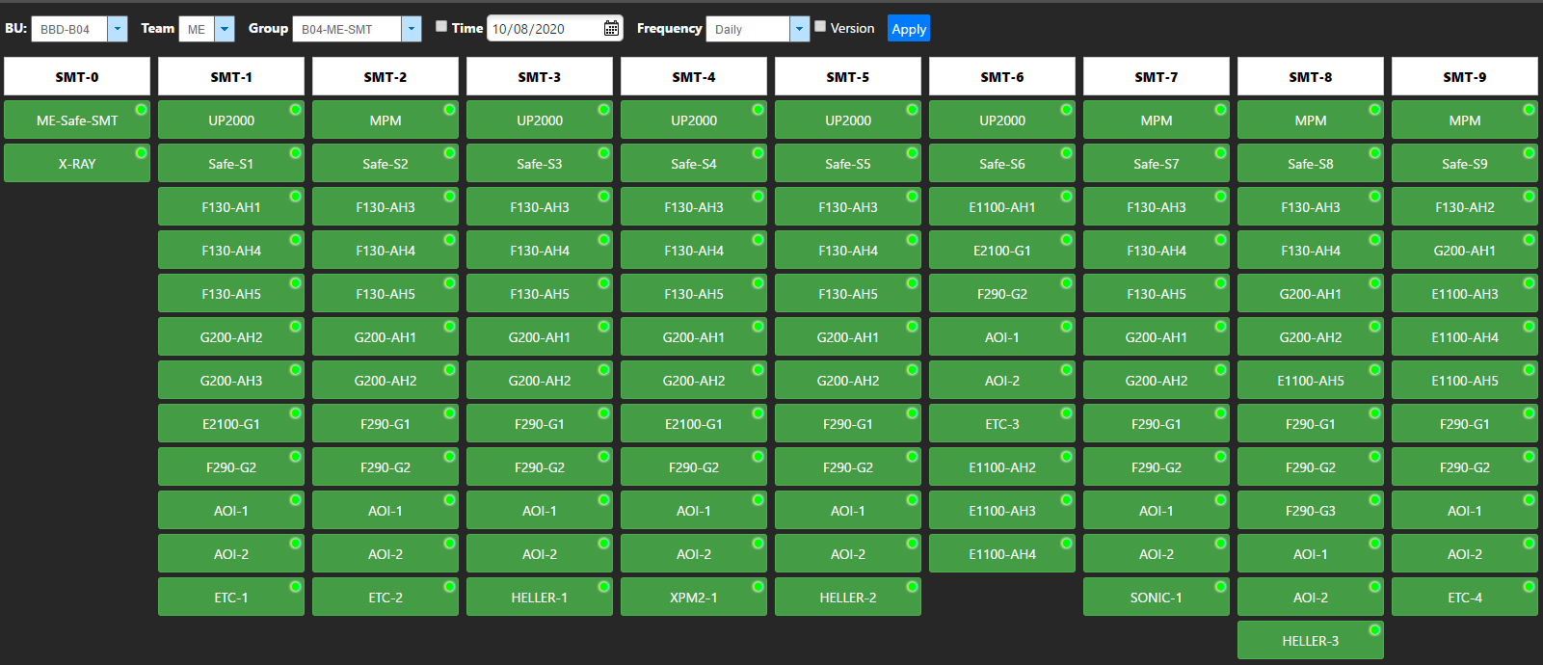
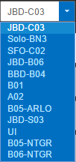
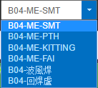
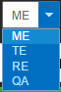
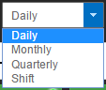
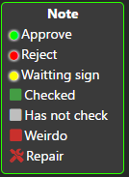
5, Report
Pick time checking
REPORT
Dashboard IPQC - FAI
Dashboard Line Machine
Choose BU
Choose Team
Choose group
Choose frequency
Analysis Abnormal
Wave soldering
Reflow status
Status checking
of QRCode
Note: Checking status checked by BU, Team, Group, Time and frequence
http://10.224.81.94:8888/paperless/me-status-line

Slide 15
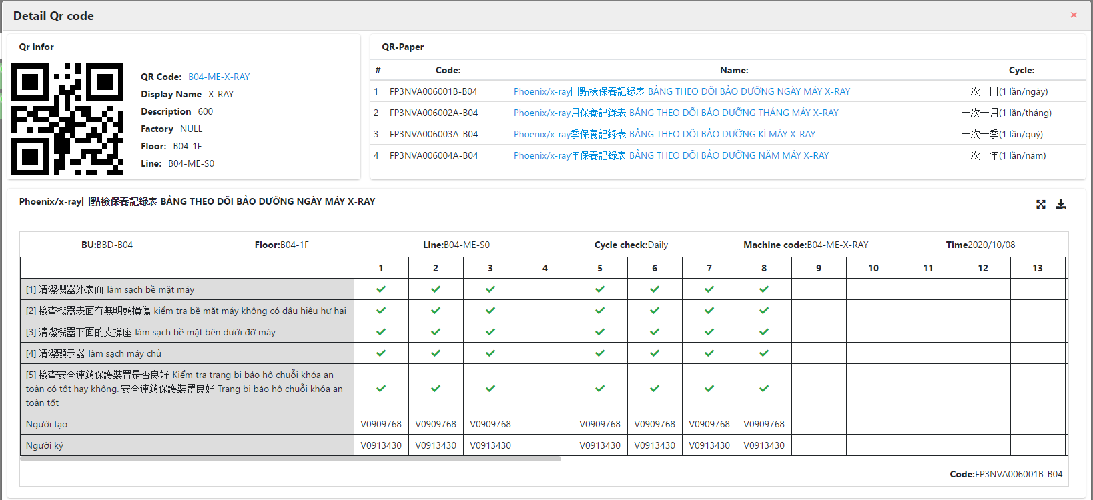
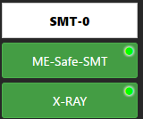
5, Report
REPORT
Dashboard IPQC - FAI
QRCode Infomation
List paper usage by QRCode
Dashboard Line Machine
Analysis Abnormal
Wave soldering
Reflow status
Click “QRCode”
Checker and reviewer
Result checked by
QRCode and Paper
Note: History checked by paper for QRCode
http://10.224.81.94:8888/paperless/me-status-line

Slide 16
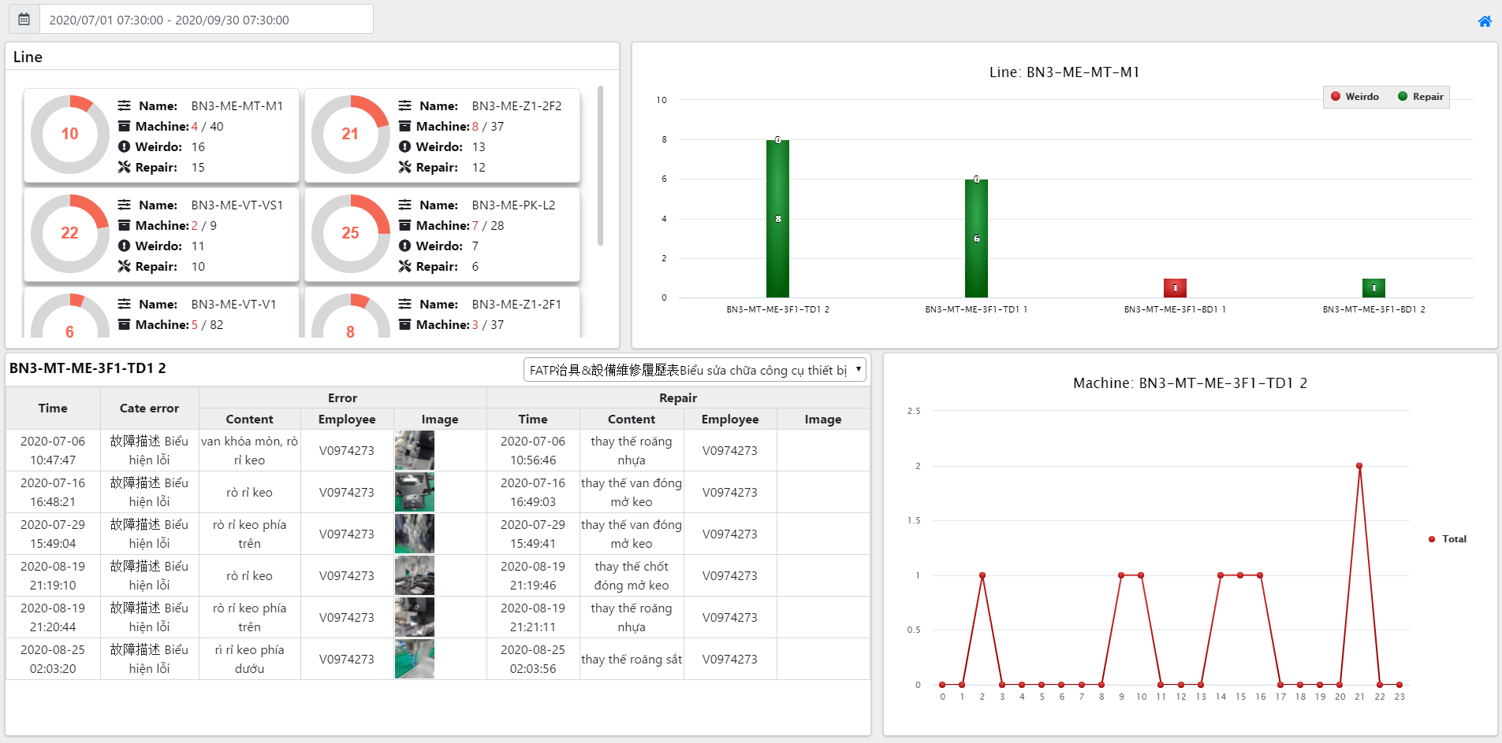
5, Report
Pick time statitic
List machine
have abnormal
REPORT
Dashboard IPQC - FAI
Dashboard Line Machine
Analysis Abnormal
Wave soldering
Reflow status
List line
have abnormal
Detail abnormal
by machine
Analysis time error
Note: Statistic abnormal
http://10.224.81.94:8888/paperless/error-machine

Slide 17
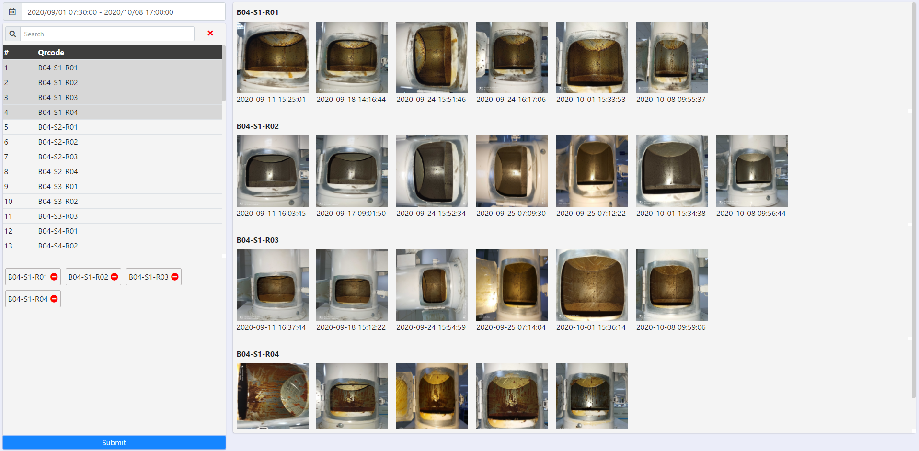
5, Report
Box search QRCode
Pick time statitic
REPORT
Dashboard IPQC - FAI
Dashboard Line Machine
Analysis Abnormal
Wave soldering
Reflow status
List QRCode
available
List QRCode
selected
Gallery group by QRCode
Note: Gallery maintain of Wave soldering and reflow for B04-ME
http://10.224.81.94:8888/paperless/media-machine

Slide 18
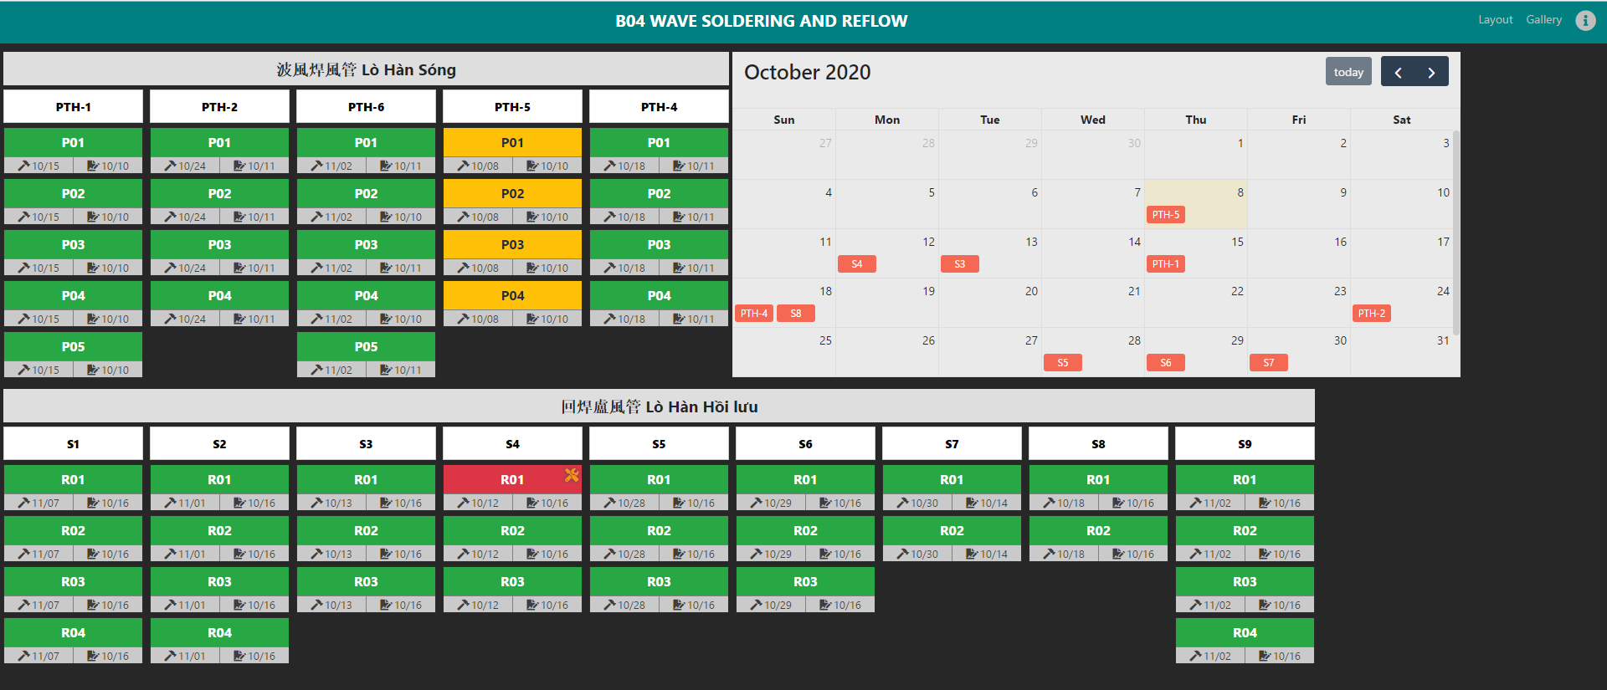
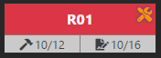
5, Report
REPORT
Dashboard IPQC - FAI
Dashboard Line Machine
Analysis Abnormal
Wave soldering
Reflow status
Color:
- Green: OK
- Yellow: Need checking
- Red: NG
Icon: Need maintain
Next time
maintain
Next time
checking
Note: Status maintain and checking of Wave soldering and reflow for B04-ME
http://10.224.81.94:8888/paperless/wave-statistic-machine

Slide 19
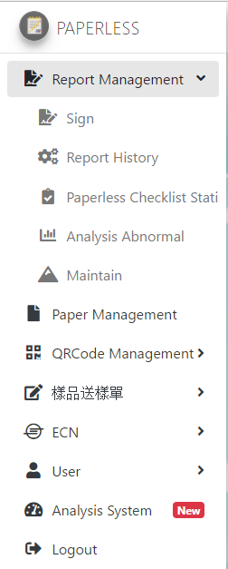
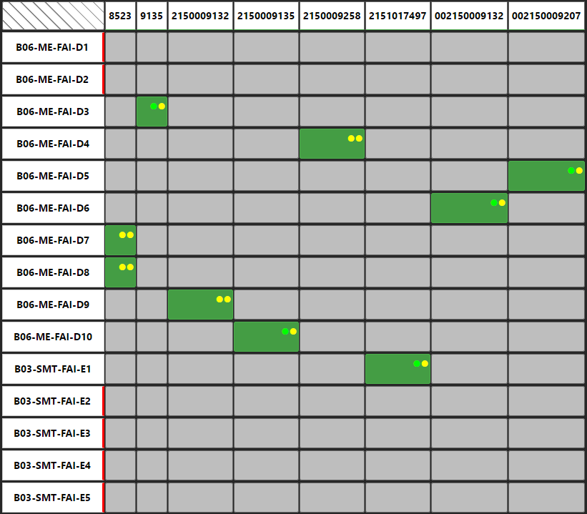
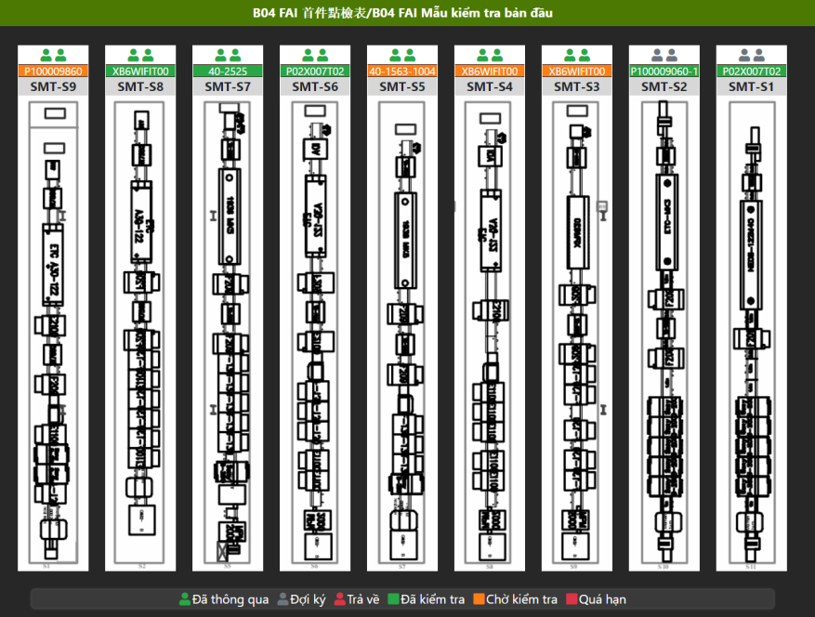
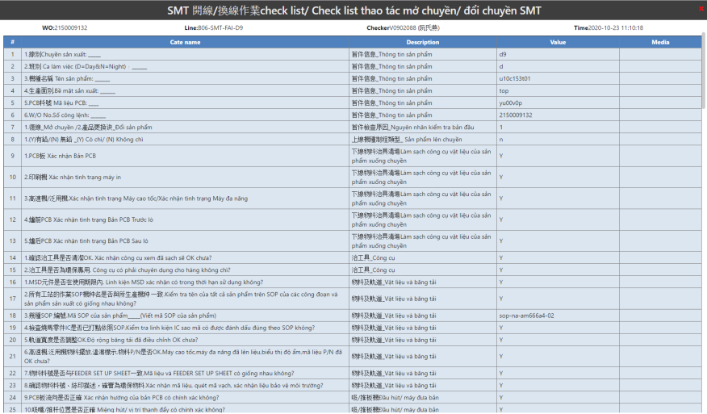
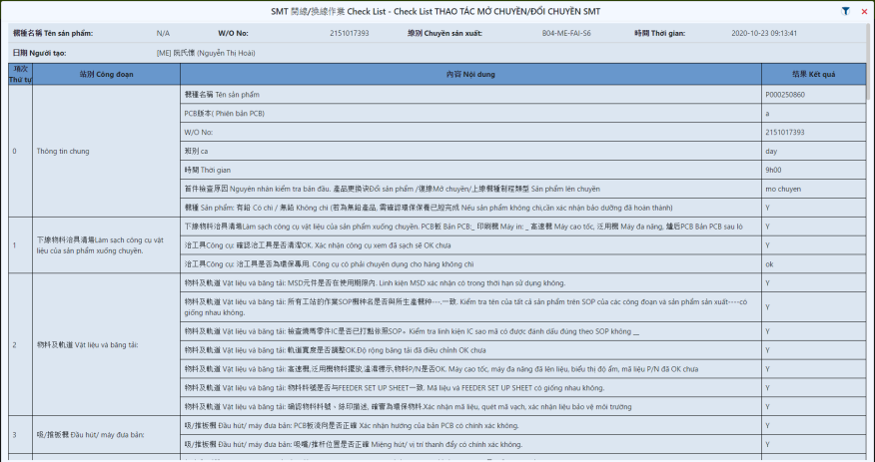
Menu
FAI
Before
After
Before
After
http://10.224.81.94:8888/paperless/me-status-line
http://10.224.81.94:8888/paperless/b04-fai-2

Slide 20
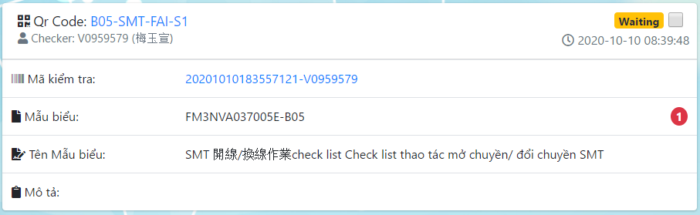
Sign waiting
Before
Waiting: 3
Approve: 5
Reject: 2
Waiting: 3
Approve: 5
Reject: 2
Waiting: 3
Approve: 5
Reject: 2
QA
ME
TE
After
http://10.224.81.94:8888/paperless/report-history?status=0

Slide 21
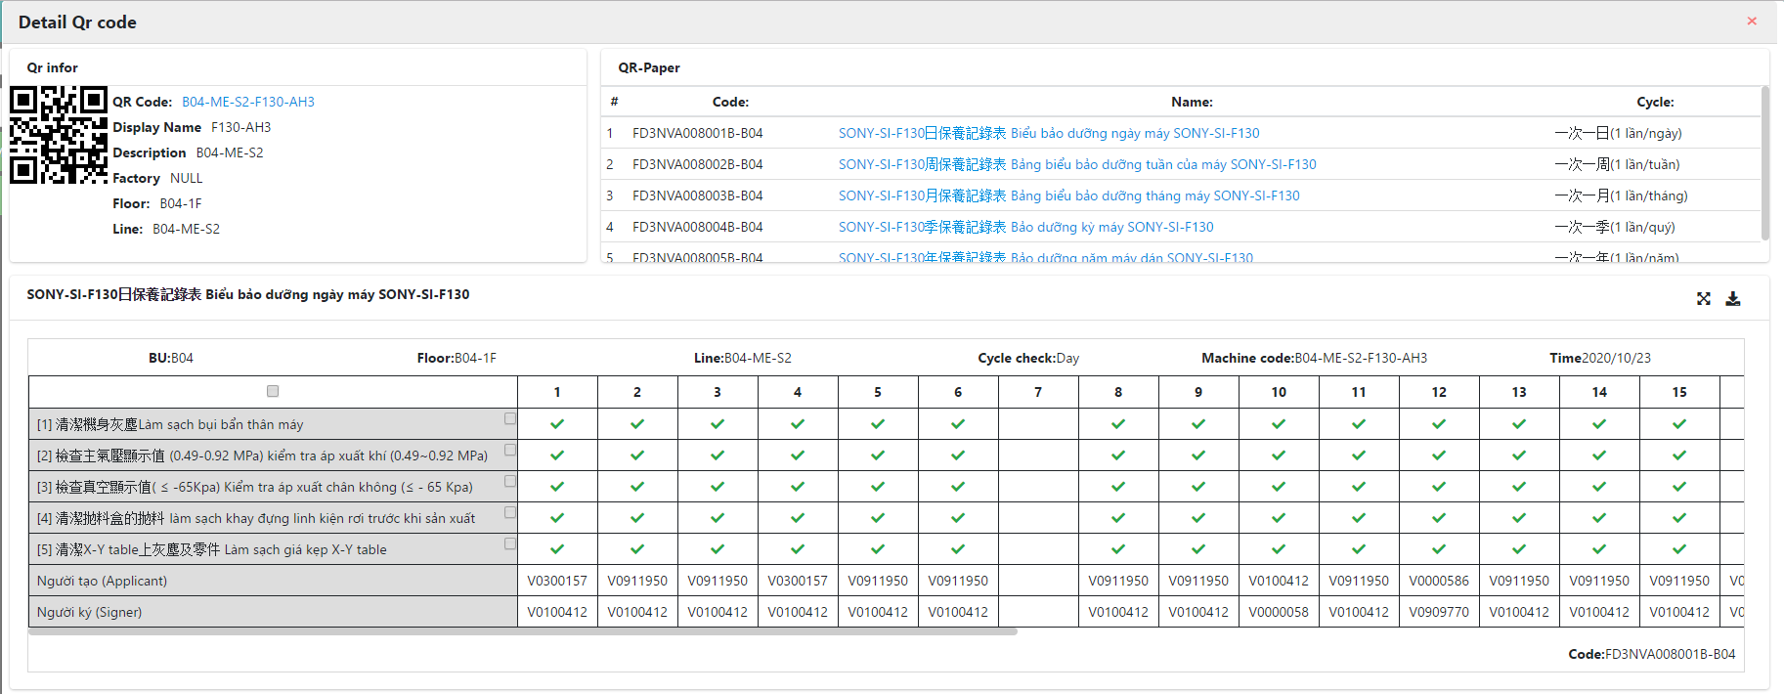
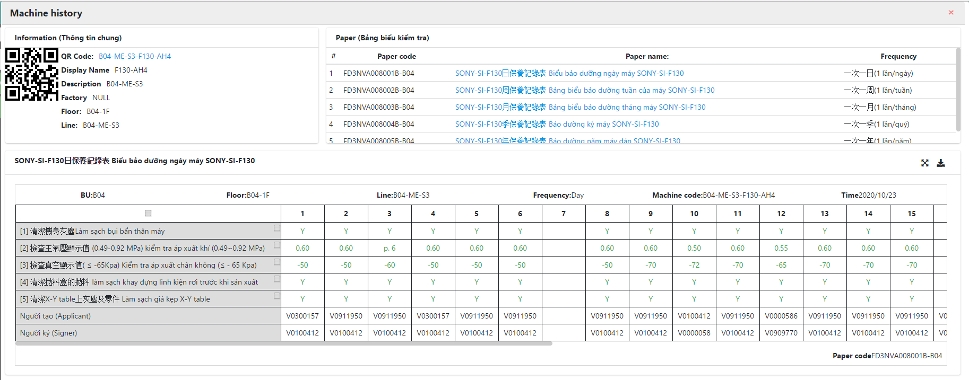
Paperless checklist statistic
Before
After

Slide 22
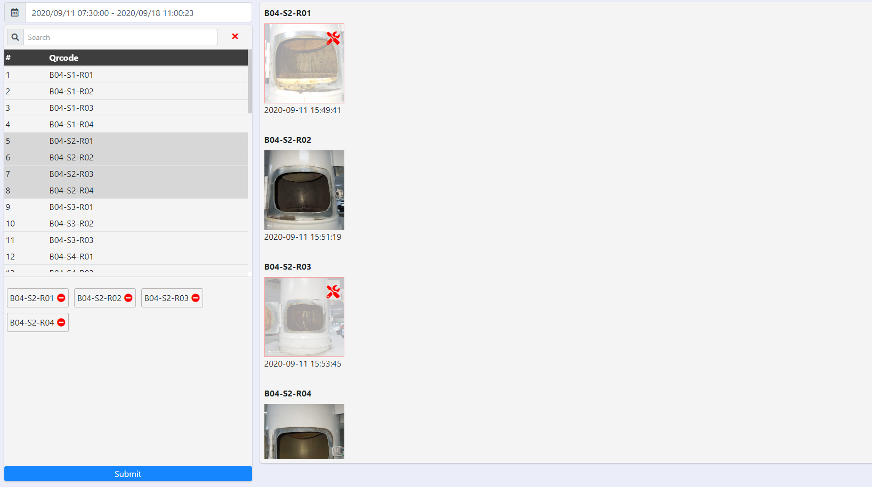
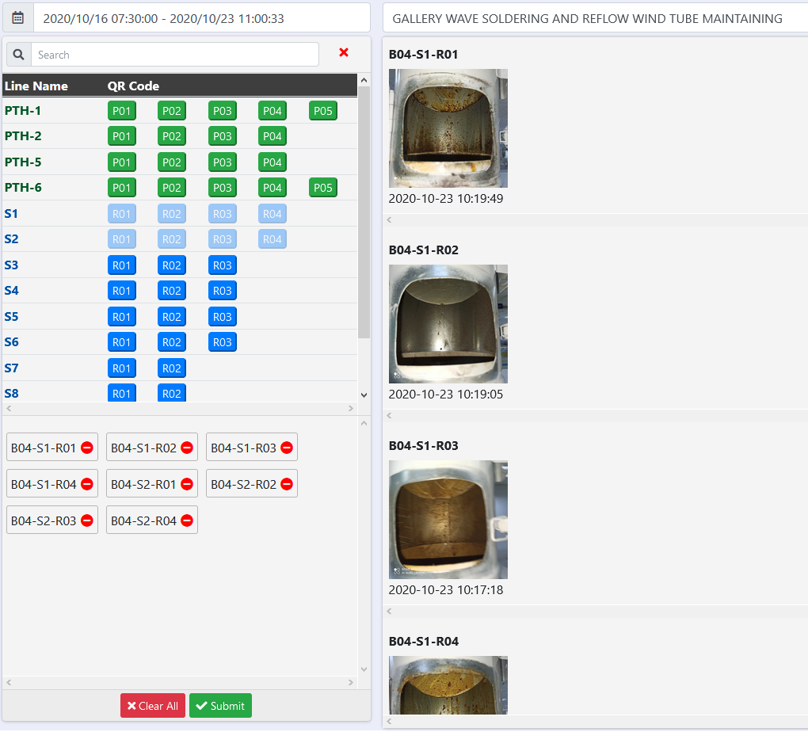
Media statistic
http://10.224.81.94:8888/paperless/wave-statistic-machine
http://10.224.81.94:8888/paperless/media-machine
Before
After

Slide 23



Support user draw chart
Update
Before
After
2, Click button draw chart
1, Choose step need draw chart
Link: http://10.224.81.94:8888/paperless/me-status-line

Slide 24


Support user Export data
Update
Link: http://10.224.81.94:8888/paperless/machine-history

Slide 25



Checklist FAI new version
Update
Status
Process
Abnormal
Done
Don’t check
Report information
Total category
Steps in category

Slide 26

Dashboard for manager(Web UI)
Update
http://10.224.81.94:8888/paperless/paperless-checklist

Slide 27


App mobile (Update)
FAI checklist
http://10.224.56.53/a/FAI.mp4
History
http://10.224.56.53/a/Check_history.mp4

Slide 28

Solution for spec and unit for step FAI (Update)
Solution
- Unit: Settings for each type of machine
- LSL – USL:
+ Settings when there is limit change
+ Setup by line, model and time
Spec
Unit
LSL - USL
Model name
Line / Machine
Time
…
(unstable)
- Type of machine
(permanent)

Slide 29


Checking and maintain for Reflow and wave soldering (Update)
Update: Show image for machine in page statistic

Slide 30

Dashboard for manager(Fill data)
Update
http://10.224.56.53:8880/paperless/paperless-checklist

Slide 31

Checking and maintain for Reflow and wave soldering (Update)
Before
After
http://10.224.81.94:8888/paperless/wave-statistic-machine

Slide 32
Spec management
1, Hệ thống không lưu trữ thông tin về đơn vị cho các hạng mục kiểm tra dựa trên loại máy
2, Không phân định và lưu trữ các bộ tham số cho model được sản xuất trên chuyền theo thời gian
3, Hệ thống không có bộ tham số cho các hạng mục để đánh giá kết quả kiểm tra của người dùng

Slide 33


Spec management
VD:
I, Thiết lập đơn vị kiểm tra cho các hạng mục
- Máy in trên truyền SMT-B04 gồm 2 loại máy (UP2000-MPM)
1, ME thống kê các loại máy trên chuyền SMT
2, Quản lý máy theo loại máy
3, Quản lý đơn vị kiểm tra trên từng loại máy
4, Cài đặt các máy lên line
Thêm mới loại máy lên hệ thống
UP2000
+
MPM
Cập nhật đơn vị kiểm tra theo hạng mục biểu
Cài đặt máy lên line
SMT-1
SMT-2
SMT-3
…
SMT-7
SMT-8
SMT-9
UP2000
UP2000
UP2000
MPM
MPM
MPM

Slide 34



Spec management
II, Thiết lập thông số kiểm tra cho các hạng mục
1, ME kiểm tra thông tin phiên bản thông số đã cài đặt trên hệ thống, nếu chưa có phiên bản nào thì thực hiện việc tạo mới trên hệ thống, nếu đã từng setup thì có thể cập nhật phiên bản, việc tạo mới hay cập nhật phiên bản spec sẽ phải thông qua lưu trình xác nhận.
2,
2.1,Trường hợp thông số chưa từng được cài đặt trên hệ thống, hệ thống sẽ cảnh báo đối với những báo cáo được tạo trong thời điểm đó và hỗ trợ người dùng việc thêm phiên bản thông số vào phần đã tạo báo cáo.
2.2, (hoặc) khi có sự thay đổi thông số trên biểu, quản trị hệ thống (Admin) sẽ chọn những chuyền có sự thay đổi và hạng mục thay đổi trong biểu, nhiệm vụ của người đi kiểm tra (chuyền trưởng) sẽ phải điền lại thông số của hạng mục được in trên SOP của hệ thống lên báo cáo, đồng thời hệ thống cũng sẽ cảnh báo đối với những hạng mục cần thay đổi thông số kiểm tra.
3, Mọi vấn đề về thay đổi thông số hay thêm mới thông số sẽ có một lưu trình để xác nhận lại các thông số đó có đúng với SOP hay không
(1)
(4)
Paperless
(5)
Admin system
Leader ME
(2)
(3)
Chuyền trưởng
(1) Khi có thay đổi tham số kiểm tra quản trị hệ thống lên hệ thống sẽ cài đặt tham số mới hoặc đặt thông báo đến người kiểm tra (chuyền trưởng)
(2) Hệ thống gửi thông báo yêu cầu cập nhật tham số cho model đến chuyền trưởng trước khi họ thực hiện kiểm tra bảng kiểm tra bản đầu trên chuyền
(3) Chuyền trưởng dựa vào tham số được ghi trong SOP trên chuyền điền lại tham số mới và gửi lại lên hệ thống
(4) Hệ thống gửi thông báo xác nhận tham số của bản đầu cho người phụ trách tham số bộ phận ME
(5) Người phụ trách sẽ lên hệ thống kiểm tra lại tham số và xác nhận bộ tham số đó có được sử dụng hay không

Slide 35



FAI checklist
Testing in SMT-S3: Install program screenshot on machine HELLER in SMT-S3
Asynchronous data model and wo in line
Step checking of station HELLER (7 step/113 step)
WO: 2154002467 <= wo of B04 <= Data model of SFC in B04
WO: 2146002478 <= wo of B05 <= Data model of SFC in B05
Solution:
Paperless FII
IT SFC
Request to SFC system and checking status of line FAI

Slide 36

Dashboard for manager(Update type)
Update
http://10.224.56.53:8880/paperless/paperless-checklist

Slide 37
FAI Checklist(New version)
Link video: http://10.224.56.53/

Slide 38
Paperless – FAI Checklist System Progress
User Side
Make Form
Check List Report
Report Management
Format Standardization
Spec, Unit definition (On Going)
Upload Data Validation (On Going)
Data collection automatic fill content (On Going)
UX design on APP
History, SPC
Dashboard on big tab, PC
Abnormal, highlight report
Sign module

Slide 39
Paperless – Online tool and equipment Management for Checklist
ME: Configure relative tool and equipment to each line and also for model as
a part code
FAI Report System
Checklist System
Output: All tool and equipment need to do checklist, maintain
OP: Scan relative part code of each station by APP when doing FAI report
Checklist system bases on FAI Report system data to define which tool and equipment online to do checklist or maintain

Slide 40

Dashboard for manager(Update data)
Update
http://10.224.81.94:8888/paperless/paperless-checklist

Slide 41

Spec management (FAI)
STT | Issue | Status
1 | Struct database (parameter + unit) | Done
2 | (FII-SW) Config unit for SMT S3 (Demo) | Done
3 | Create/Update UI spec management page | Ongoing
Machine Type
(Reflow/Printer)
Setup unit for machine
Add machine to line
http://10.224.81.94:8888/paperless/b04-fai-2

Slide 42


Statistic data check/uncheck in paperless system
Shiftly
Data don’t check at (2020-11-25 Shift Day)
Yearly
Daily
QRCode
(Checklist)
Machine
Tool
Quarterly
Weekly
Monthly
Data quantity
by line
Machine
Line
Line
Machine
Can’t check
Stop
Run
Can check
Data check FAI report
(Check by model)
Tool
Model
Model
Tool
Can’t check
Not produced
Run
Can check

Slide 43


Update FAI
- Auto fill general in FAI checklist
- Add item “tools use for model” in FAI checklist -> checking data check and uncheck by frequence for tools
- Connect server ME and get data machine in line
Auto fill general in FAI checklist
Connect server ME get data
1, Check FAI
FII
Server
2, Request
ME server
5, Fill data
to report FAI
3, Data log
4, Process data log
Auto fill

Slide 44

Setup unit for Line
Setup success for S1-S9 (http://10.224.81.94:8888/paperless/b04-fai-2)

Slide 45

FAI AutoFill
General FAI report (4/5)
Follow with repuest of customer
Auto fill data

Slide 46

Update process loading data resoure(Thumbnail Image)
Update create file thumbnail for media file:
Size of image: 1Mb ~ 5Mb
Size of thumbnail: 2Kb ~ 4Kb
=> Reduce waiting time
http://10.224.81.94:8888/paperless/wave-statistic-machine

Slide 47

Solution read data machine
New Solution(Testing SMT-S2)
Current Solution
Apply for Reflow (S3, S5)
Applicability is low
Checker
Open program
screenshot
Checker
1, Check FAI
Program
(Screenshoot &
Print QRCode)
Reflow
(get data machine)
Web service
Program
(Screenshoot)
4, Data machine
Paperless System
2, Request get image
Server ME
Reflow
Scan data
Send screenshot
3, Output (Image)
Paperless
Open program
screenshot
Check
FAI
Processing image
Checker
Checker

Slide 48
Solution checking data ECN
Paperless
(System)
PM
Create
ECN report
FAI
Checklist
Checking PN code
Special request form
Add ECN detail
to FAI report
ECN Evaluation
Send data ECN/PN
IT Allpart
(System)
Approve
report
Other Dept
Check PN
IQC
Update ECN Evaluation Form for PM
Provide API to collect material list to IT base on ECN Evaluation System
API to update status of ECN Evaluation after IQC check new arrived material
Special Application data collection from IT API then update to FAI Validation
Material

Slide 49

ECN Evaluation Application Control
2. Special Application List
Complete ECN Evaluation Application List
FAI
Checklist
ECN Evaluation
1. List PN
IT Allpart
(System)
System
IQC check arrived PN
Submit ECN number or Special Application number
Notify to complete ECN Evaluation Application
Run ECN Evaluation Application with list PN
Effective or not
Fill Special Application
number
Check arrived PN
ME
PM
ME
IQC
User
Ensure production line is using correct ECN and Special Application for PN list
Enhance FAI checklist system’s Validation Module per submit from production line while doing FAI checklist

Slide 50


BOM Config & Flux Statistic
BOM config
Flux Statistic

Slide 51

FAI Config

Slide 52
Solution read data machine
Checker
Testing install program
1, Check FAI
(get data machine)
Web service
Program
(Screenshoot)
4, Data machine
Paperless System
2, Request get image
Server ME
Request screenshot
Reflow
(Program screenshot)
3, Output (Image)
Data image
Open program
screenshot
Processing image
Checker

Slide 53




Connect from Server ME to Reflow
Server FII
(Paperless)
10.224.81.94
Server ME
10.224.81.100
3, Request screenshot
by machine
2, Request get data machine
1, Get data machine
6, Return Image
4, Connect form server to machine and screenshot sceen machine
5, Send data
to server ME
7, Result
Auto fill
(IT Checking open port connect data)
Auto fill
Reflow
(192.168.35.xxx)
Reflow
(192.168.35.xxx)
…
Reflow
(192.168.35.xxx)
Auto fill
Install (Use port 26152)

Slide 54

Update form ECN
Add new item PN before/PN after/location

Slide 55







User
System
- Data processing based on data has been collected (Text + Image)
- Form: Modeling and synchronizing data representation
NG
OK
ISO
- Report + Sign: Performance improvements
Paperless
Version 2
- Connect to IT, TE, ME,… server and exchange data
TE
Other
- Data management: Data analysis and data statistic
FII
ME
IT
- UI/UX: View, process, notification
- Connect device in line then read device information

Slide 56









Paperless project
Abnormal
PN
SaaS
Layer
HR
Checklist
FAI
Maintain
ECN
Sample
Covid
PaaS
Layer
Program version
Parameter of machine
Model
Validation by step
Device and machine
Multimedia
Other system
Create report
Statistic report
Analysis data
Line
Machine
Device
Other
Add form
Content management
Update version
Permission
Role
Add Model
Statistic capacity
Spec management
Validation
Data collection
Report
QRCode
Form
User
Model
IaaS
Layer
Switch
virtual machine datacenter
Nadder
Workstation
DL360
PC
Mobile
Bigtab
Machine
Core
layer

Slide 57
FAI
SaaS
Layer
FAI
ECN Evaluation
PaaS
Layer
Program version
Parameter of machine
Model
Validation by step
Device and machine
Multimedia
Other system
Add Line
QRCode management
Notify alarm checking
Add form
Content management
Update version
Permission
Role
Add Model
Statistic capacity
Spec management
Validation
Data collection
Line
Form
User
Model
IaaS
Layer
Switch
virtual machine datacenter
Nadder
Workstation
DL360
PC
Mobile
Bigtab
Machine
Core
layer

Slide 58







Data collection (Before)
Document
Read document

Slide 59
ME Service
Connect
Connect
Connect
Connect
Paperless
10.224.81.94
IT Allpart

Slide 60

Solution double check ECN
PE
PQE
PC
IE
ME
MPM
IPQC
PD
7, Send notify
6, Check PN
4, Check PN
Paperless
(ECN)
10.224.81.94
2, Send list PN
need check to Allpart
Webservice
Allpart
5, Send PN detail
- ECN infomation
- List PN
1, Create ECN report
3, Scan PN
PM
IQC

